Slide 1
Drift Velocity

Slide 2
Content
1 Experimental Data Gathering
2. Computation Model
3. Performance with Training Set

Slide 3
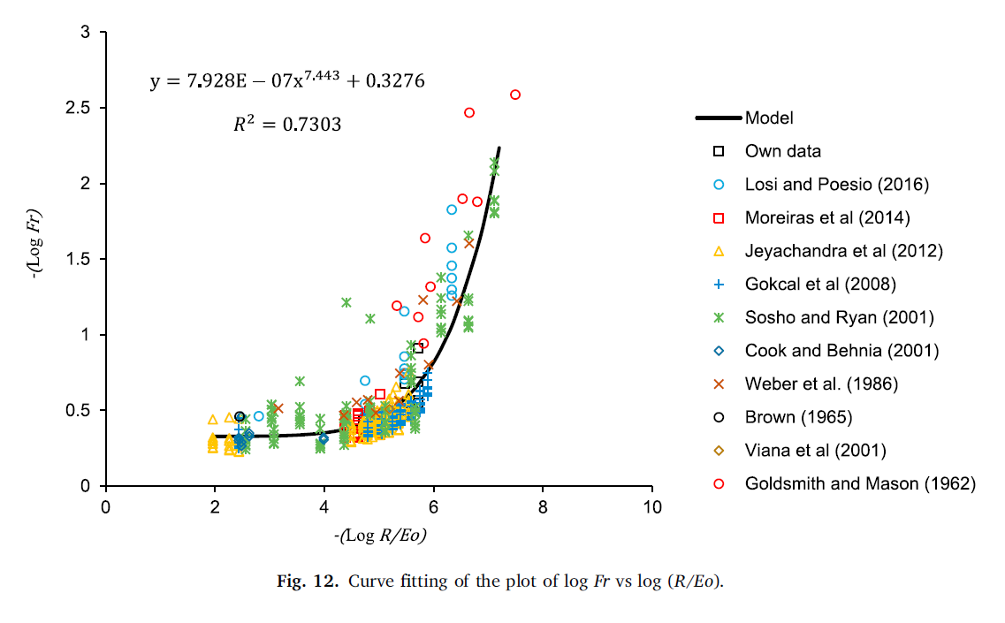
1. Experimental Data Gathering

Slide 4
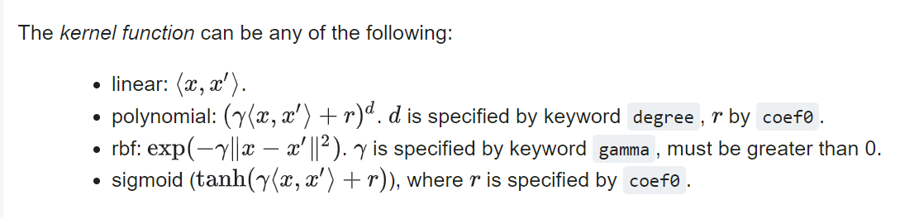
2. Computational Model
Model:
https://github.com/VictorPuglieseManotas/Research/blob/master/Drift%20Velocity%20Analysis.ipynb
Support Vectors
Dual Coefficients
Intercept

Slide 5
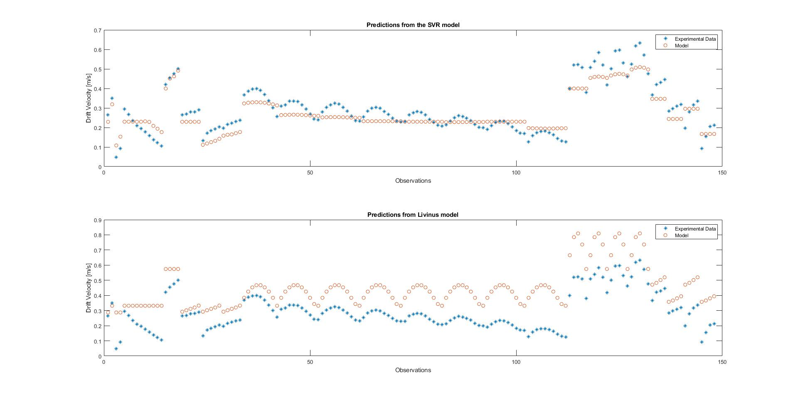
3. Performance with Training Set

Slide 6
3. Manuscript Outline
Drift Velocity Model for Taylor Bubble in High Viscosity stagnant liquids in pipes using Support Vector Regression
Abstract
Introduction
Experimental procedure
Data analysis using Support Vector Regression
Simulations results (?)
Conclusions

